Slide 1
Algoritma & Pemrograman
Functions (1)
Prepared by
Frans Panduwinata, S.Kom, M.T

Slide 2
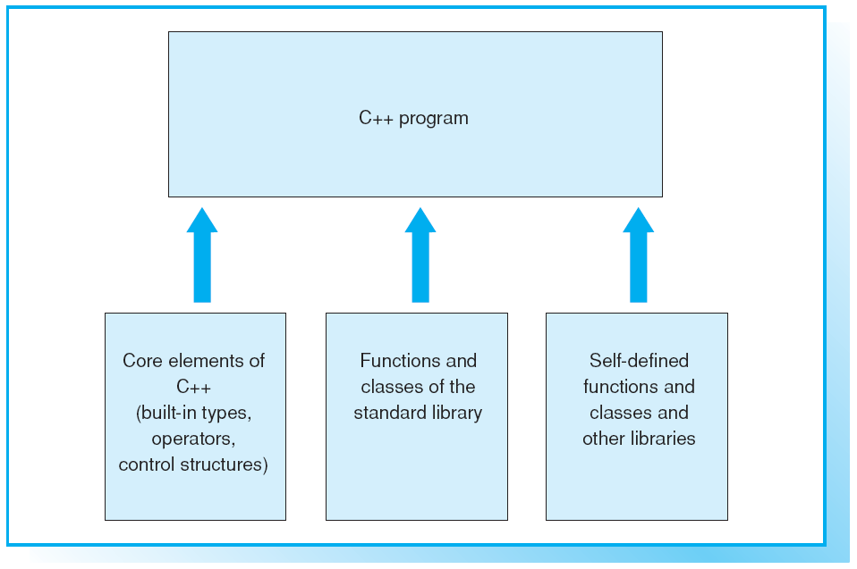
Elements of a C++ Program

Slide 3
Libraries
Many useful global functions and classes are available from the C++ standard library.
You can enhance the reusability of your source code by compiling your own libraries, but be sure to include comments for ease of readability.

Slide 4
Function Definition
Functions can be defined in any order, however, the first function is normally main.
This makes the program easier to understand, since you start reading at the point where the program starts to execute.

Slide 5
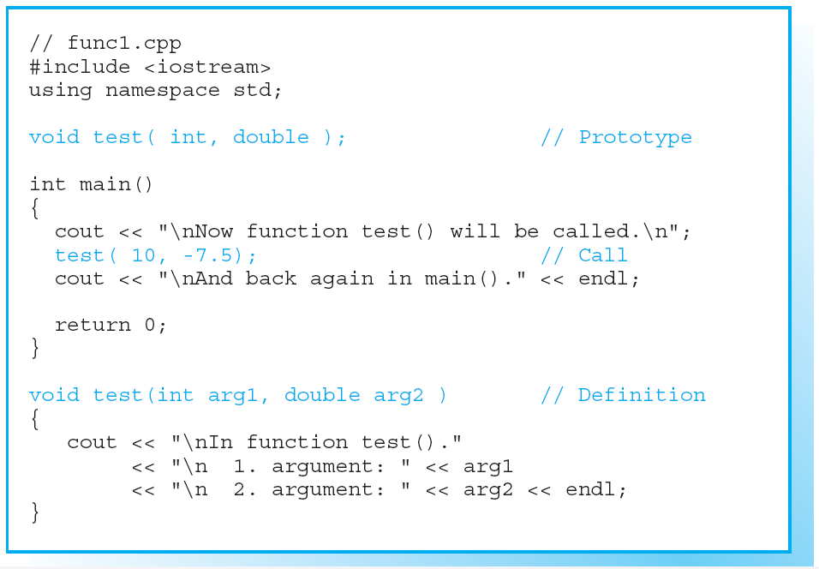
Example of a Function Definition

Slide 6
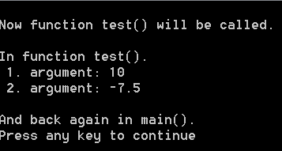
Example of a Function Definition (cont)
Screen Output:

Slide 7
General Form of a Function
General form of a function:
  type is the function type, that is, the type of the return value.
  name is the function name, which is formed like a variable name and should indicate the purpose of the function.
  declaration_list contains the names of the parameters and declares their types.
    The list can be empty, as for the function main(), for example.
    A list of declarations that contains only the word void is equivalent to an empty list.

Slide 8
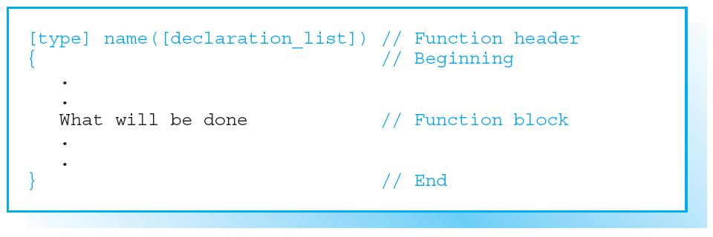
General Form of a Function (cont)

Slide 9
General Form of a Function (cont)
The parameters declared in a list are no more than local variables.
They are created when the function is called and initialized by the values of the arguments.
EXAMPLE:
When test( 10, -7.5); is called,
the parameter arg1 is initialized with a value of 10 and arg2 with -7.5.

Slide 10
Prototype and Definition
In a function definition the function header is similar in form to the prototype of a function.
The only difference when a function is defined is that the name and declaration list are not followed by a semicolon but by a function code block.
The prototype is the declaration of the function and thus describes only the formal interface of that function.

Slide 11
Prototype and Definition (cont)
The prototype provides the compiler with all the information it needs to perform the following actions when a function is called:
  check the number and type of the arguments
  correctly process the return value of the function.

Slide 12
Return Statement
When the program flow reaches a return statement or the end of a function code block, it branches back to the function that called it.
If the function is any type other than void, the return statement will also cause the function to return a value to the function that called it.
SYNTAX:
return [expression]
The return expression is normally placed in parentheses if it contains operators.

Slide 13
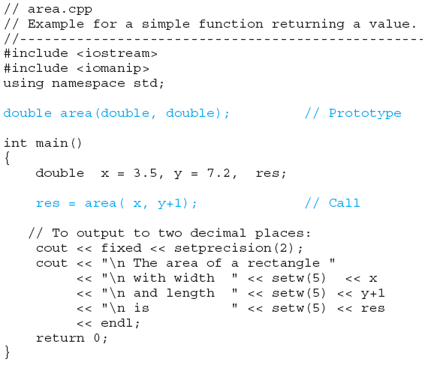
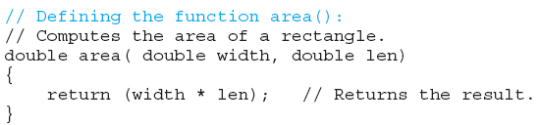
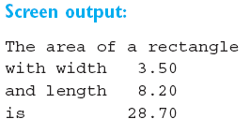
Defining and Calling the Function area()

Slide 14
Passing by Value
Passing values to a function when the function is called is referred to as passing by value.
Function arguments can also be passed by reference.
In this case, the function is passed a reference to an object as an argument and can therefore access the object directly and modify it.

Slide 15
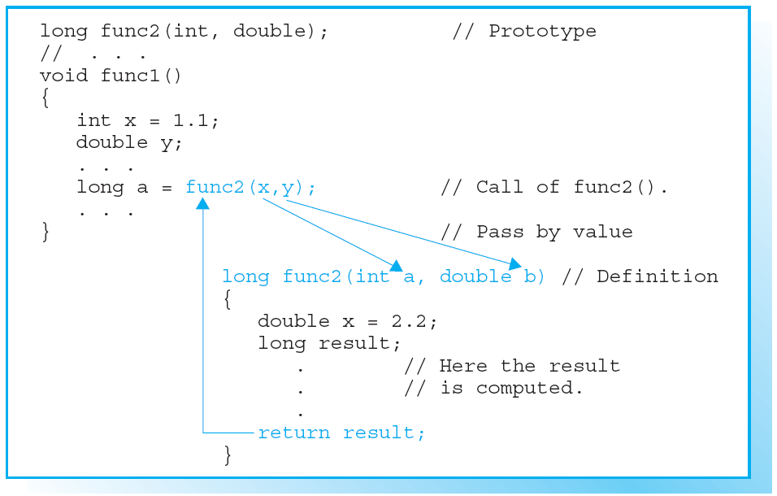
Local Objects
The scope of function
parameters and the
objects defined within
a function applies
only to the function
block.

Slide 16
EXERCISES

